Slide 1
Unit 4:
Requirement Engineering

Slide 2
The requirements for a system are the descriptions of what the system should do— the services that it provides and the constraints on its operation.
These requirements reflect the needs of customers for a system that serves a certain purpose such as controlling a device, placing an order, or finding information.
The process of finding out, analyzing, documenting and checking these services and constraints is called requirements engineering (RE).
The term requirement is not used consistently in the software industry.
In some cases, a requirement is simply a high-level, abstract statement of a service that a system should provide or a constraint on a system. At the other extreme, it is a detailed, formal definition of a system function.

Slide 3
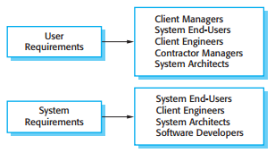
Distinguish between the term
User Requirements to mean the high-level abstract requirements
System Requirements to mean the detailed description of what the system should do
Readers of different types of requirements specification

Slide 4
Definition:
User requirements are statements, in a natural language plus diagrams, of what services the system is expected to provide to system users and the constraints under which it must operate.
System requirements are more detailed descriptions of the software system’s functions, services, and operational constraints. The system requirements document (sometimes called a functional specification) should define exactly what is to be implemented. It may be part of the contract between the system buyer and the software developers.

Slide 5
Functional and Non-Functional Requirements
Software system requirements are often classified as:
Functional requirements: These are statements of services the system should provide, how the system should react to particular inputs, and how the system should behave in particular situations. In some cases, the functional requirements may also explicitly state what the system should not do.
Non-functional requirements: These are constraints on the services or functions offered by the system. They include timing constraints, constraints on the development process, and constraints imposed by standards. Non-functional requirements often apply to the system as a whole, rather than individual system features or services.

Slide 6
Functional and Non-Functional Requirements
Functional requirements:
The functional requirements for a system describe what the system should do.
These requirements depend on the type of software being developed, the expected users of the software, and the general approach taken by the organization when writing requirements.
When expressed as user requirements, functional requirements are usually described in an abstract way that can be understood by system users.

Slide 7
Functional and Non-Functional Requirements
Functional requirements:
More specific functional system requirements describe the system functions, its inputs and outputs, exceptions, etc., in detail
Functional system requirements vary from general requirements covering what the system should do to very specific requirements reflecting local ways of working or an organization’s existing systems.
Imprecision in the requirements specification is the cause of many software engineering problems. It is natural for a system developer to interpret an ambiguous requirement in a way that simplifies its implementation. This is not what the customer wants. New requirements have to be established and changes made to the system. Of course, this delays system delivery and increases costs.

Slide 8
Functional and Non-Functional Requirements
Functional requirements:
In principle, the functional requirements specification of a system should be both complete and consistent.
Completeness means that all services required by the user should be defined.
Consistency means that requirements should not have contradictory definitions.

Slide 9
Functional and Non-Functional Requirements
Non-Functional requirements:
Non-functional requirements are requirements that are not directly concerned with the specific services delivered by the system to its users.
They may relate to emergent system properties such as reliability, response time, and store occupancy.
They may define constraints on the system implementation such as the capabilities of I/O devices or the data representations used in interfaces with other systems.
Non-functional requirements, such as performance, security, or availability, usually specify or constrain characteristics of the system as a whole.

Slide 10
Functional and Non-Functional Requirements
Non-Functional requirements:
Non-functional requirements are often more critical than individual functional requirements.
System users can usually find ways to work around a system function that doesn’t really meet their needs.
Failing to meet a non-functional requirement can mean that the whole system is unusable
It is often more difficult to relate components to non-functional requirements.

Slide 11
Functional and Non-Functional Requirements
Non-Functional requirements:
The implementation of these requirements may be diffused throughout the system.
There are two reasons for this:
Non-functional requirements may affect the overall architecture of a system rather than the individual components. For example, to ensure that performance requirements are met, you may have to organize the system to minimize communications between components.
A single non-functional requirement, such as a security requirement, may generate a number of related functional requirements that define new system services that are required. In addition, it may also generate requirements that restrict existing requirements.

Slide 12
Functional and Non-Functional Requirements
Non-Functional requirements:
Non-functional requirements arise through user needs, because of budget constraints, organizational policies, the need for interoperability with other software or hardware systems, or external factors such as safety regulations or privacy legislation

Slide 13
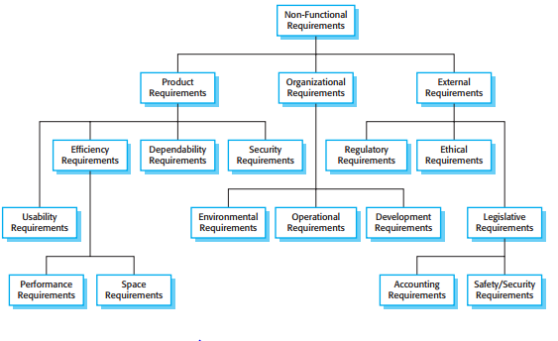
Functional and Non-Functional Requirements
Non-Functional requirements:
The non-functional requirements may come from required characteristics of the software (product requirements), the organization developing the software (organizational requirements), or from external sources

Slide 14
Functional and Non-Functional Requirements
Non-Functional requirements:
Product requirements
These requirements specify or constrain the behavior of the software.
Examples include performance requirements on how fast the system must execute and how much memory it requires, reliability requirements that set out the acceptable failure rate, security requirements, and usability requirements.

Slide 15
Functional and Non-Functional Requirements
Non-Functional requirements:
Organizational requirements
These requirements are broad system requirements derived from policies and procedures in the customer’s and developer’s organization.
Examples include operational process requirements that define how the system will be used, development process requirements that specify the programming language, the development environment or process standards to be used, and environmental requirements that specify the operating environment of the system.

Slide 16
Functional and Non-Functional Requirements
Non-Functional requirements:
External requirements
This broad heading covers all requirements that are derived from factors external to the system and its development process.
These may include regulatory requirements that set out what must be done for the system to be approved for use by a regulator, such as a central bank; legislative requirements that must be followed to ensure that the system operates within the law; and ethical requirements that ensure that the system will be acceptable to its users and the general public.

Slide 17
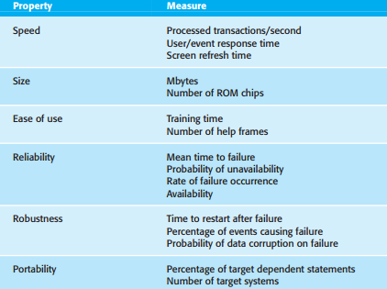
Functional and Non-Functional Requirements
Non-Functional requirements:
We should write non-functional requirements quantitatively so that they can be objectively tested.
Metrics that you can use to specify non-functional system properties.
We can measure these characteristics when the system is being tested to check whether or not the system has met its nonfunctional requirements.

Slide 18
Functional and Non-Functional Requirements
Non-Functional requirements:
Non-functional requirements such as reliability, safety, and confidentiality requirements are particularly important for critical systems.

Slide 19
The software Requirement Document
The software requirements document (sometimes called the software requirements specification or SRS) is an official statement of what the system developers should implement.
It should include both the user requirements for a system and a detailed specification of the system requirements. Sometimes, the user and system requirements are integrated into a single description.
In other cases, the user requirements are defined in an introduction to the system requirements specification. If there are a large number of requirements, the detailed system requirements may be presented in a separate document

Slide 20
The software Requirement Document
Requirements documents are essential when an outside contractor is developing the software system.
Example
Agile development methods argue that requirements change so rapidly that a requirements document is out of date as soon as it is written, so the effort is largely wasted.
Rather than a formal document, approaches such as Extreme Programming collect user requirements incrementally and write these on cards as user stories.
The user then prioritizes requirements for implementation in the next increment of the system.

Slide 21
The software Requirement Document
For business systems where requirements are unstable, this approach is a good one. However, it is still useful to write a short supporting document that defines the business and dependability requirements for the system; it is easy to forget the requirements that apply to the system as a whole when focusing on the functional requirements for the next system release.
The requirements document has a diverse set of users, ranging from the senior management of the organization that is paying for the system to the engineers responsible for developing the software.

Slide 22
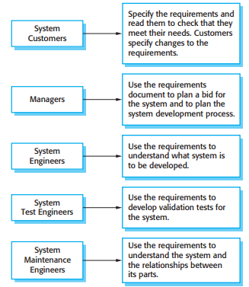
The software Requirement Document
Users of
a requirements document

Slide 23
The software Requirement Document
The diversity of possible users means that the requirements document has to be a compromise between communicating the requirements to customers, defining the requirements in precise detail for developers and testers, and including information about possible system evolution.
Information on anticipated changes can help system designers avoid restrictive design decisions and help system maintenance engineers who have to adapt the system to new requirements

Slide 24
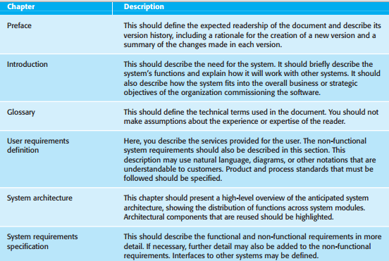
The software Requirement Document

Slide 25
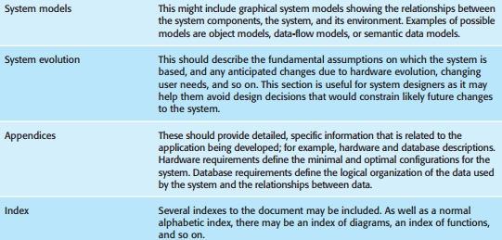
The software Requirement Document
This shows one possible organization for a requirements document that is based on an IEEE standard for requirements documents (IEEE, 1998). This standard is a generic standard that can be adapted to specific uses.

Slide 26
Requirements Specification
Requirements specification is the process of writing down the user and system requirements in a requirements document. Ideally, the user and system requirements should be clear, unambiguous, easy to understand, complete, and consistent.

Slide 27
Requirements Specification
User Requirements
The user requirements for a system should describe the functional and nonfunctional requirements so that they are understandable by system users who don’t have detailed technical knowledge.
They should specify only the external behavior of the system. The requirements document should not include details of the system architecture or design.
Consequently, if you are writing user requirements, you should not use software jargon, structured notations, or formal notations.
You should write user requirements in natural language, with simple tables, forms, and intuitive diagrams.

Slide 28
Requirements Specification
System Requirements
System requirements are expanded versions of the user requirements that are used by software engineers as the starting point for the system design.
They add detail and explain how the user requirements should be provided by the system.
They may be used as part of the contract for the implementation of the system and should therefore be a complete and detailed specification of the whole system.
It should simply describe the external behavior of the system and its operational constraints. They should not be concerned with how the system should be designed or implemented.

Slide 29
Requirements Specification
It is practically impossible to exclude all design information. There are several reasons for this:
You may have to design an initial architecture of the system to help structure the requirements specification. The system requirements are organized according to the different sub-systems that make up the system.
In most cases, systems must interoperate with existing systems, which constrain the design and impose requirements on the new system.
The use of a specific architecture to satisfy non-functional requirements may be necessary. An external regulator who needs to certify that the system is safe may specify that an already certified architectural design be used.

Slide 30
Requirements Specification
User requirements are almost always written in natural language supplemented by appropriate diagrams and tables in the requirements document.
System requirements may also be written in natural language but other notations based on forms, graphical system models, or mathematical system models can also be used.
The possible notations that could be used for writing system requirements are as follows:

Slide 31
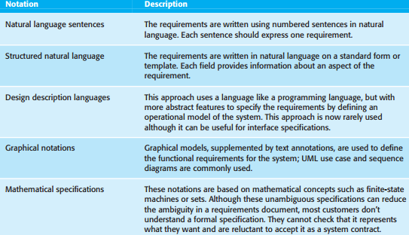
Requirements Specification
The possible notations that could be used for writing system requirements are as follows:
Ways of writing a system requirements specification

Slide 32
Requirements Specification
Assignment on:
Natural language specification
Structured specifications

Slide 33
Requirements Engineering Processes
It may include four high-level activities.
These focus on assessing if
the system is useful to the business (feasibility study)
discovering requirements (elicitation and analysis)
converting these requirements into some standard form (specification)
checking that the requirements actually define the system that the customer wants (validation).

Slide 34
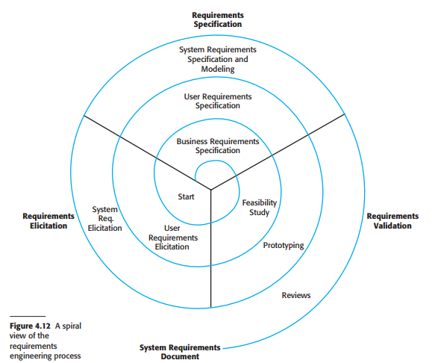
Requirements Engineering Processes
A spiral view of the
requirements
engineering process

Slide 35
Requirements Engineering Processes
The activities are organized as an iterative process around a spiral, with the output being a system requirements document.
The amount of time and effort devoted to each activity in each iteration depends on the stage of the overall process and the type of system being developed.
Early in the process, most effort will be spent on understanding high-level business and non-functional requirements, and the user requirements for the system.
Later in the process, in the outer rings of the spiral, more effort will be devoted to eliciting and understanding the detailed system requirements

Slide 36
Requirements Engineering Processes
The spiral model accommodates approaches to development where the requirements are developed to different levels of detail. The number of iterations around the spiral can vary so the spiral can be exited after some or all of the user requirements have been elicited.
Agile development can be used instead of prototyping so that the requirements and the system implementation are developed together.

Slide 37
Requirements Engineering Processes
Some consider requirements engineering to be the process of applying a structured analysis method, such as object-oriented analysis. This involves analyzing the system and developing a set of graphical system models, such as use case models, which then serve as a system specification.
The set of models describes the behavior of the system and is annotated with additional information describing, for example, the system’s required performance or reliability.

Slide 38
Requirements Elicitation and Analysis
After an initial feasibility study, the next stage of the requirements engineering process is requirements elicitation and analysis.
In this activity, software engineers work with customers and system end-users to find out about the application domain, what services the system should provide, the required performance of the system, hardware constraints, and so on.

Slide 39
Requirements Elicitation and Analysis
It may involve a variety of different kinds of people in an organization. A system stakeholder is anyone who should have some direct or indirect influence on the system requirements.
Stakeholders include:
End-users who will interact with the system and anyone else in an organization who will be affected by it.
Might be Engineers who are developing or maintaining other related systems, business managers, domain experts, and trade union representatives.
A system stakeholder is anyone who should have some direct or indirect influence on the system requirements.

Slide 40
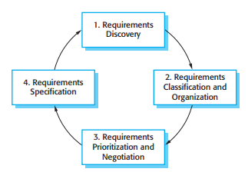
Requirements Elicitation and Analysis
The requirements elicitation and analysis process

Slide 41
Requirements Elicitation and Analysis
The process activities are:
Requirements discovery
This is the process of interacting with stakeholders of the system to discover their requirements.
Domain requirements from stakeholders and documentation are also discovered during this activity.

Slide 42
Requirements Elicitation and Analysis
The process activities are:
2. Requirements classification and organization
This activity takes the unstructured collection of requirements, groups related requirements, and organizes them into coherent clusters.
The most common way of grouping requirements is to use a model of the system architecture to identify sub-systems and to associate requirements with each sub-system.
In practice, requirements engineering and architectural design cannot be completely separate activities.

Slide 43
Requirements Elicitation and Analysis
3. Requirements prioritization and negotiation
When multiple stakeholders are involved, requirements will conflict. This activity is concerned with prioritizing requirements and finding and resolving requirements conflicts through negotiation.
Stakeholders have to meet to resolve differences and agree on compromise requirements.

Slide 44
Requirements Elicitation and Analysis
4. Requirements specification
The requirements are documented and input into the next round of the spiral.
Formal or informal requirements documents may be produced.

Slide 45
Requirements Elicitation and Analysis
Requirements elicitation and analysis is an iterative process with continual feedback from each activity to other activities.
The process cycle starts with requirements discovery and ends with the requirements documentation.
The analyst’s understanding of the requirements improves with each round of the cycle.
The cycle ends when the requirements document is complete

Slide 46
Requirements Elicitation and Analysis
Eliciting and understanding requirements from system stakeholders is a difficult process for several reasons:
Stakeholders often don’t know what they want from a computer system except in the most general terms; they may find it difficult to articulate what they want the system to do; they may make unrealistic demands because they don’t know what is and isn’t feasible.
Stakeholders in a system naturally express requirements in their own terms and with implicit knowledge of their own work. Requirements engineers, without experience in the customer’s domain, may not understand these requirements.

Slide 47
Requirements Elicitation and Analysis
Different stakeholders have different requirements and they may express these in different ways. Requirements engineers have to discover all potential sources of requirements and discover commonalities and conflict.
Political factors may influence the requirements of a system. Managers may demand specific system requirements because these will allow them to increase their influence in the organization.
The economic and business environment in which the analysis takes place is dynamic. It inevitably changes during the analysis process. The importance of particular requirements may change. New requirements may emerge from new stakeholders who were not originally consulted.

Slide 48
Requirements Validation
Requirements validation is the process of checking that requirements actually define the system that the customer really wants.
It overlaps with analysis as it is concerned with finding problems with the requirements.
Requirements validation is important because errors in a requirements document can lead to extensive rework costs when these problems are discovered during development or after the system is in service.

Slide 49
Requirements Validation
During the requirements validation process, different types of checks should be carried out on the requirements in the requirements document. These checks include:
Validity checks : A user may think that a system is needed to perform certain functions. However, further thought and analysis may identify additional or different functions that are required. Systems have diverse stakeholders with different needs and any set of requirements is inevitably a compromise across the stakeholder community.
Consistency checks: Requirements in the document should not conflict. That is, there should not be contradictory constraints or different descriptions of the same system function.

Slide 50
Requirements Validation
Completeness checks: The requirements document should include requirements that define all functions and the constraints intended by the system user.
Realism checks: Using knowledge of existing technology, the requirements should be checked to ensure that they can actually be implemented. These checks should also take account of the budget and schedule for the system development.
Verifiability: To reduce the potential for dispute between customer and contractor, system requirements should always be written so that they are verifiable. This means that you should be able to write a set of tests that can demonstrate that the delivered system meets each specified requirement.

Slide 51
Requirements Validation
There are a number of requirements validation techniques that can be used individually or in conjunction with one another:
Requirements reviews: The requirements are analyzed systematically by a team of reviewers who check for errors and inconsistencies.
Prototyping: In this approach to validation, an executable model of the system in question is demonstrated to end-users and customers. They can experiment with this model to see if it meets their real needs.

Slide 52
Requirements Validation
Test-case generation:
Requirements should be testable.
If the tests for the requirements are devised as part of the validation process, this often reveals requirements problems.
If a test is difficult or impossible to design, this usually means that the requirements will be difficult to implement and should be reconsidered.
Developing tests from the user requirements before any code is written is an integral part of extreme programming.

Slide 53
Requirements Management
Requirements management is the process of understanding and controlling changes to system requirements.
Needs to keep track of individual requirements and maintain links between dependent requirements so that you can assess the impact of requirements changes.
Needs to establish a formal process for making change proposals and linking these to system requirements.
The formal process of requirements management should start as soon as a draft version of the requirements document is available.
However, you should start planning how to manage changing requirements during the requirements elicitation process.

Slide 54
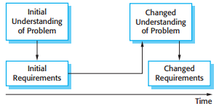
Requirements Management
Requirements evolution

Slide 55
Requirements Management
Once a system has been installed and is regularly used, new requirements inevitably emerge.
It is hard for users and system customers to anticipate what effects the new system will have on their business processes and the way that work is done.
Once end-users have experience of a system, they will discover new needs and priorities.

Slide 56
Requirements Management
There are several reasons why change is inevitable:
The business and technical environment of the system always changes after installation. New hardware may be introduced, it may be necessary to interface the system with other systems, business priorities may change (with consequent changes in the system support required), and new legislation and regulations may be introduced that the system must necessarily abide by.

Slide 57
Requirements Management
There are several reasons why change is inevitable:
The people who pay for a system and the users of that system are rarely the same people. System customers impose requirements because of organizational and budgetary constraints. These may conflict with end-user requirements and, after delivery, new features may have to be added for user support if the system is to meet its goals.

Slide 58
Requirements Management
There are several reasons why change is inevitable:
Large systems usually have a diverse user community, with many users having different requirements and priorities that may be conflicting or contradictory. The final system requirements are inevitably a compromise between them and, with experience, it is often discovered that the balance of support given to different users has to be changed.

Slide 59
Requirements Management
Requirements Management Planning
Planning is an essential first stage in the requirements management process. The planning stage establishes the level of requirements management detail that is required.

Slide 60
Requirements Management
Requirements Management Planning
During the requirements management stage, you have to decide on:
Requirements identification: Each requirement must be uniquely identified so that it can be cross-referenced with other requirements and used in traceability assessments.
A change management process: This is the set of activities that assess the impact and cost of changes.
Traceability policies: These policies define the relationships between each requirement and between the requirements and the system design that should be recorded. The traceability policy should also define how these records should be maintained.

Slide 61
Requirements Management Planning
Tool support: Requirements management involves the processing of large amounts of information about the requirements. Tools that may be used range from specialist requirements management systems to spreadsheets and simple database systems.

Slide 62
Requirements Management
Requirements Management Planning
Requirements management needs automated support and the software tools for this should be chosen during the planning phase.
Needs tool support for:
Requirements storage: The requirements should be maintained in a secure, managed data store that is accessible to everyone involved in the requirements engineering process.
Change management: The process of change management is simplified if active tool support is available.

Slide 63
Requirements Management
Requirements Management Planning
Traceability management: Tool support for traceability allows related requirements to be discovered. Some tools are available which use natural language processing techniques to help discover possible relationships between requirements.
For small systems, it may not be necessary to use specialized requirements management tools.
For larger systems, more specialized tool support is required.

Slide 64
Requirements Management
Requirements Change Management
Requirements change management should be applied to all proposed changes to a system’s requirements after the requirements document has been approved.
Change management is essential because you need to decide if the benefits of implementing new requirements are justified by the costs of implementation.

Slide 65
Requirements Management
Requirements Change Management
The advantage of using a formal process for change management is that all change proposals are treated consistently and changes to the requirements document are made in a controlled way.

Slide 66

Requirements Management
Principles of Requirements Change Management

Slide 67
Principal of Requirements Change Management
There are three principal stages to a change management process:
Problem analysis and change specification:
The process starts with an identified requirements problem or, sometimes, with a specific change proposal.
During this stage, the problem or the change proposal is analyzed to check that it is valid.
This analysis is fed back to the change requestor who may respond with a more specific requirements change proposal, or decide to withdraw the request.

Slide 68
Principal of Requirements Change Management
Change analysis and costing:
The effect of the proposed change is assessed using traceability information and general knowledge of the system requirements.
The cost of making the change is estimated both in terms of modifications to the requirements document and, if appropriate, to the system design and implementation.
Once this analysis is completed, a decision is made whether or not to proceed with the requirements change.

Slide 69
Principal of Requirements Change Management
Change implementation:
The requirements document and, where necessary, the system design and implementation, are modified.
You should organize the requirements document so that you can make changes to it without extensive rewriting or reorganization.
As with programs, changeability in documents is achieved by minimizing external references and making the document sections as modular as possible.
Thus, individual sections can be changed and replaced without affecting other parts of the document.

Slide 70
Requirements Management
Requirements Change Management
Agile development processes, such as extreme programming, have been designed to cope with requirements that change during the development process.
In these processes, when a user proposes a requirements change, this change does not go through a formal change management process.
Rather, the user has to prioritize that change and, if it is high priority, decide what system features that were planned for the next iteration should be dropped.

